Slide 1




PRESENTS:
MS-Excel Workshop
BY:-
SHILESH MISHRA
Data Analyst & Trainer

Slide 2

Before we start !

Slide 3
Workshop Course Content
MS Excel Workshop
Introduction to MS-Excel
Sorting and Filters
Logical Functions & Lookups
Date & Time and Text Functions
Summarizing Functions
Creating and Formatting Charts
Pivot Tables
Securing Data
Introduction to Macros
We will be going through each and every topic using practical examples.

Slide 4
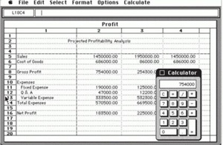
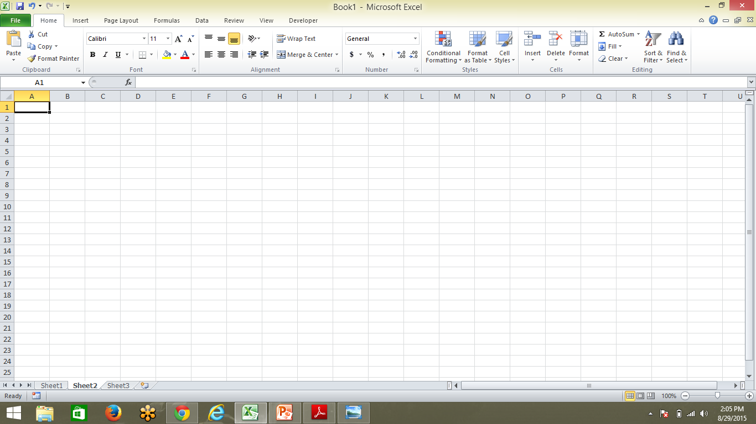
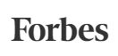
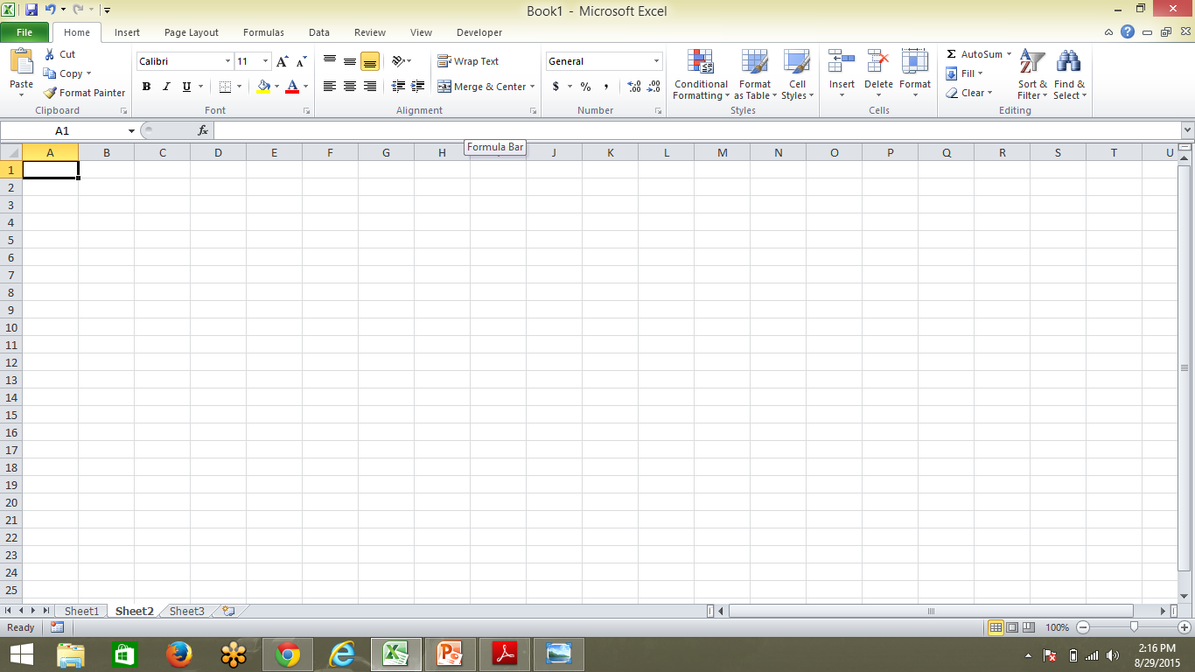
Introduction to MS-Excel
Microsoft Excel is a spreadsheet application developed by Microsoft for Microsoft Windows, Mac OS X, and iOS. It features calculation, graphing tools, pivot tables, and a macro programming language called Visual Basic for Applications.
Microsoft originally marketed a spreadsheet program called Multiplan in 1982. Microsoft released the first version of Excel for the Macintosh on September 30, 1985, and the first Windows version was 2.05 in November 1987.
Multiplan
This is how Excel looks today!
Microsoft's Excel Might Be The Most Dangerous Software On The Planet
Todays Excel has best in class GUI which makes it popular to be used by corporates and industries to store and analyze their data
Excel GUI
Latest version of MS-Excel is Excel-2016.
Notes:
Multiplan became very popular on CP/M systems, but on MS-DOS systems it lost popularity toLotus 1-2-3.

Slide 5
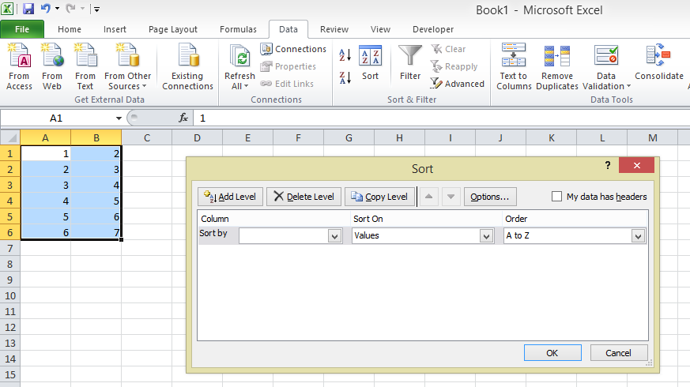
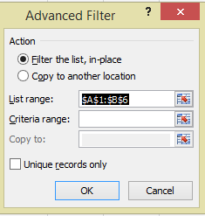
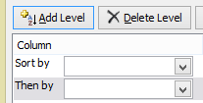
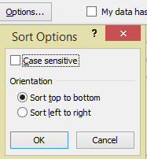
Sorting and Filters
Topics :-
Sorting
Filters
Single & Multi-Level Sorting
Sorting by Color/Icon
Row Level Sorting
Extracting Records with Filter
Using wildcard characters in Filter
Both Sorting and Filter options are available in Data tab. They are also present in Home tab for quick usage.
Here we will discuss about ADVNCED FILTER option in detail
We can use “AND” and “OR” criteria to do Advanced Filtering of Data.
We use Criteria Range to provide our condition for Filtering Data. The condition should be noted in cells and then those cells should be selected.
Go to DATA tab -> Go to SORT option -> SORT dialogue box opens.
Select the SORT BY option. Then SORT ON option and Finally ORDER option.
For Multi level sorting use ADD LEVEL option.
For Row level sorting use OPTIONS and select “Sort Left to Right”
Wildcard Characters are used primarily to locate Strings which are not known completely. There are 2 wildcard characters – “*” & “?”.
Excel* means Excellent or Excels etc.
Excel? means Excels
~ (tilde) – It is used to identify a wildcard character (~, *, ?) in the text. For example, let’s say you want to find the exact phrase excel* in a list. If you use excel* as the search string it would give you any word that has excel at the beginning followed by any number of characters (such as excel, excels, excellent). To specifically look for excel*, we need to use ~. So our search string would be excel~*. Here, the presence of ~ ensures that excel reads the following character as is, and not as a wildcard.

Slide 6
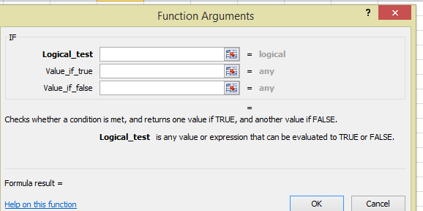
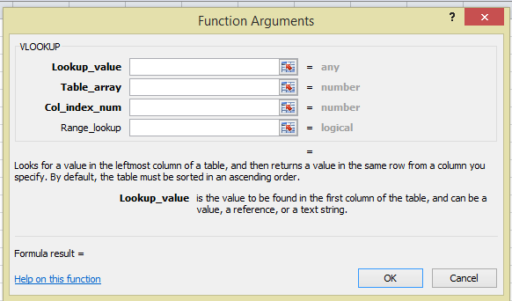
Logical Functions & Lookups
Topics :-
Logical
Lookup
Using Simple IF
Nested IF functions
VLOOKUP and HLOOKUP functions
Using IFERROR along with Lookup Functions
IF and Nested IF
VLOOKUP and HLOOKUP
IF is used as Logical statement.
HLOOKUP
Looks in the top row of an array and returns the value of the indicated cell
VLOOKUP
Looks in the first column of an array and moves across the row to return the value of a cell.
In IF function, we first provide Logical test which is a conditional statement. Then we input the values that we want as output when the condition is TRUE or FALSE.
Nested IF is used for successive conditions.
The syntax of the function is: IFERROR( value, value_if_error )

Slide 7
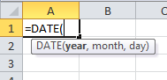

Date & Time and Text Functions
Topics :-
Date&Time
Text
TODAY
NOW
DATE
DAY, MONTH, YEAR
LEN
CONCATENATE
UPPER, LOWER, PROPER
S. No. | Function | Usage
1 | TODAY | Returns current date
2 | NOW | Returns current date and time
3 | DATE | Returns a date, from a user-supplied year, month and day.
4 | DAY | To get the day of a date
5 | MONTH | To get the month of a date
6 | YEAR | To get the year of a date
S. No. | Function | Usage
1 | LEN | Returns the length of string
2 | CONCATENATE | Joins 2 or more strings
3 | UPPER | Converts all characters to upper case of a string.
4 | LOWER | Converts all characters to lower case of a string.
5 | PROPER | Converts all characters to proper case .
For example
syntax for CONCATENATE function is ->
For example syntax for DATE function is ->
Date and Time are Character function so there are special operations to make it as Numeric.

Slide 8
Summarizing Functions
Topics :-
SUM, SUMIF
AVERAGE, AVERAGEA, AVERAGEIF
COUNT, COUNTA, COUNTIF
Summarizing Functions are the functions used to find Descriptive Statistics of any data.
S. No. | Function | Usage
1 | SUM | Returns the sum of a supplied list of numbers
2 | SUMIF | Adds the cells in a supplied range, that satisfy a given criteria
3 | AVERAGE | Returns the Average of a list of supplied numbers
4 | AVERAGEA | Returns the Average of a list of supplied numbers, counting text and the logical value FALSE as the value 0 and counting the logical value TRUE as the value 1
5 | AVERAGEIF | Calculates the Average of the cells in a supplied range, that satisfy a given criteria
6 | COUNT | Returns the number of numerical values in a supplied set of cells or values
7 | COUNTA | Returns the number of non-blanks in a supplied set of cells or values
8 | COUNTIF | Returns the number of cells (of a supplied range), that satisfy a given criteria
# Averageif was a new function in excel-07.

Slide 9
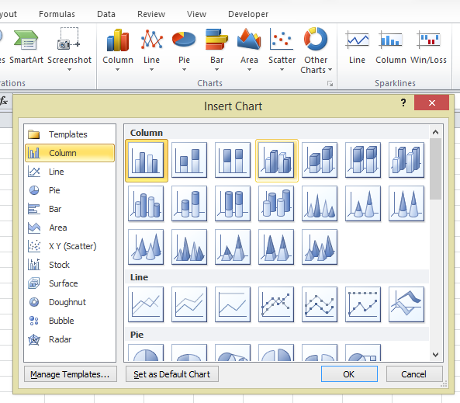
Creating and Formatting Charts
Topics :-
To create charts :-
Go to INSERT option -> Go to CHARTS option -> Choose required chart.
Creating Charts
Formatting Charts
Percentage Contribution Charting
Formatting Charts
We have 3 primary CHART TOOLS namely:-
Design
Layout , and
Format
We will discuss each formatting option on Excel Sheet.
We can use stacked column graphs as well as pie charts to represent percentage contribution charting.

Slide 10
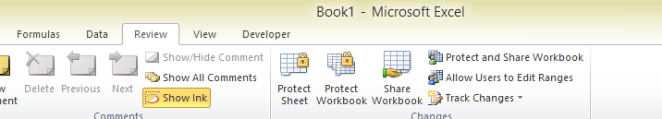
Securing Data
Topics :-
File Level security
Sheet Level security
Cell Level security
Excel provides a very interactive GUI for Security.

Slide 11
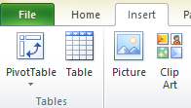
Pivot Tables
Topics :-
Creating, Formatting Simple PivotTables
Slicers
Timeline
Creating/Modifying a PivotChart
Changing the Summary Function
Grand Totals and Sub totals
Report Layouts
Pivot Styles
For using SUBTOTAL option first of all Sort the data on Variable SUBTOTAL is to be done.

Slide 12
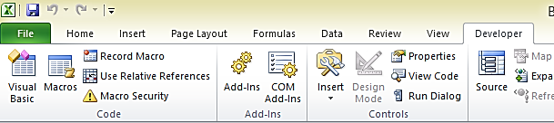
Introduction to Macros
Topics :-
Macro Basics
Using Macro Recorder

Slide 13
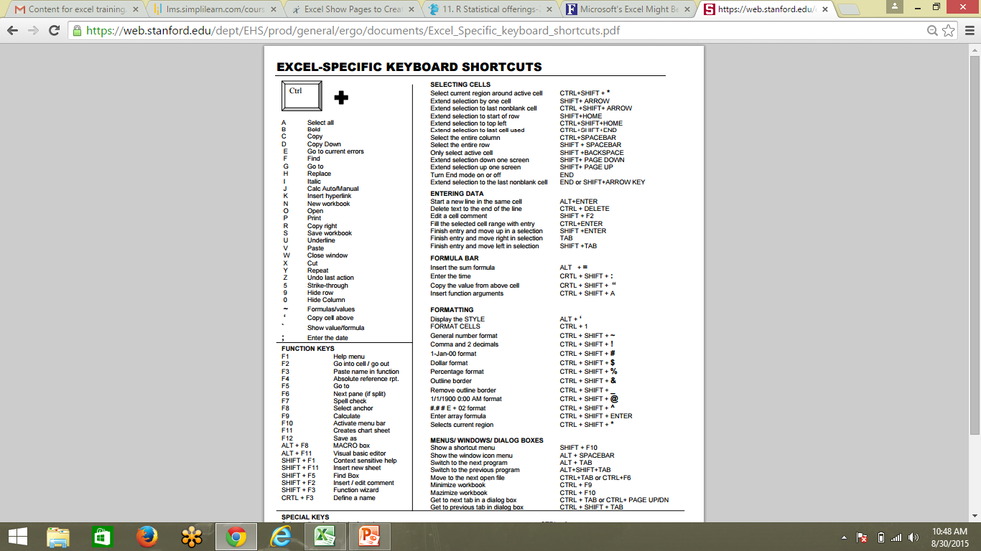
Excel Keyboard Shortcuts

Slide 14
THANKS
Now we will be having our Q&A sessions

